Slide 1
Lecture 11 Heaps
Department of Computer Science
Hofstra University
Acknowledgement: Lecture slides based on UofW Course on Data Structures

Slide 2
2) Insertion Sort
4 | 3 | 2 | 1 | 0 | 5
Insert 3
3 | 4 | 2 | 1 | 0 | 5
Insert 2
Insert 1
1 | 2 | 3 | 4 | 0 | 5
2 | 3 | 4 | 1 | 0 | 5
Insert 0
0 | 1 | 2 | 3 | 4 | 5
Insert 5
0 | 1 | 2 | 3 | 4 | 5

Slide 3
s-t Connectivity Problem
s-t Connectivity Problem
3
Given source vertex s and a target vertex t, does there exist a path between s and t?
1
6
s
0
4
7
t
2
5
An algorithm for connected(s, t)
8
We can use recursion: if a neighbor of s is connected to t, that means s is also connected to t!

Slide 4
s-t Connectivity Problem with Recursion
Solution: Mark each node as visited!
Set<Vertex> visited; // assume global
connected(Vertex s, Vertex t) {
if (s == t) {
return true;
} else {
visited.add(s);
for (Vertex n : s.neighbors) {
if (!visited.contains(n)) {
if (connected(n, t)) {
return true;
}
}
}
return false;
}
}
3
1
6
s
0
4
7
t
2
5
8
Notes:
This general approach for crawling through a graph is going to be the basis for a LOT of algorithms!

Slide 5
Using BFS for the s-t Connectivity Problem
stCon(Graph graph, Vertex start, Vertex t) {
Queue<Vertex> perimeter = new Queue<>();
Set<Vertex> visited = new Set<>();
perimeter.add(start);
visited.add(start);
while (!perimeter.isEmpty()) {
Vertex from = perimeter.remove();
if (from == t) { return true; }
for (Edge edge : graph.edgesFrom(from)) {
Vertex to = edge.to();
if (!visited.contains(to)) {
perimeter.add(to);
visited.add(to);
}
}
}
return false;
}
s-t Connectivity Problem
Given source vertex s and a target vertex t, does there exist a path between s and t?
Use BFS, and check each visited node to see if we’ve reached t
DFS would also work here

Slide 6
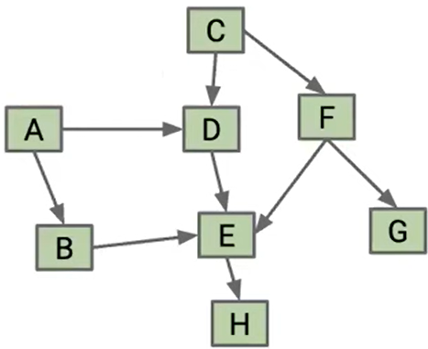
DFS Traversal Example IV
Starting from node A:
Pre-order traversal is (A, B, E, H, D, C, F, G)
Post-order traversal is (H, E, B, D, A, G, F, C)
Topological Sort is (C, F, G, A, D, B, E, H)
Quiz: Starting from node C, ‘
Pre-order traversal is (A, B, E, H, D, C, F, G)
Post-order traversal is (H, E, B, D, A, G, F, C)
Topological Sort is (C, F, G, A, D, B, E, H)
post-order traversal is “ ”; Topological Sort is “ ”
Notes:
Pre-order traversal is (A, B, E, H, D, C, F, G)
Post-order traversal is (H, E, B, D, A, G, F, C)
Topological Sort is (C, F, G, A, D, B, E, H)
C, D, E, H, F, G, A, B

